Slide 1
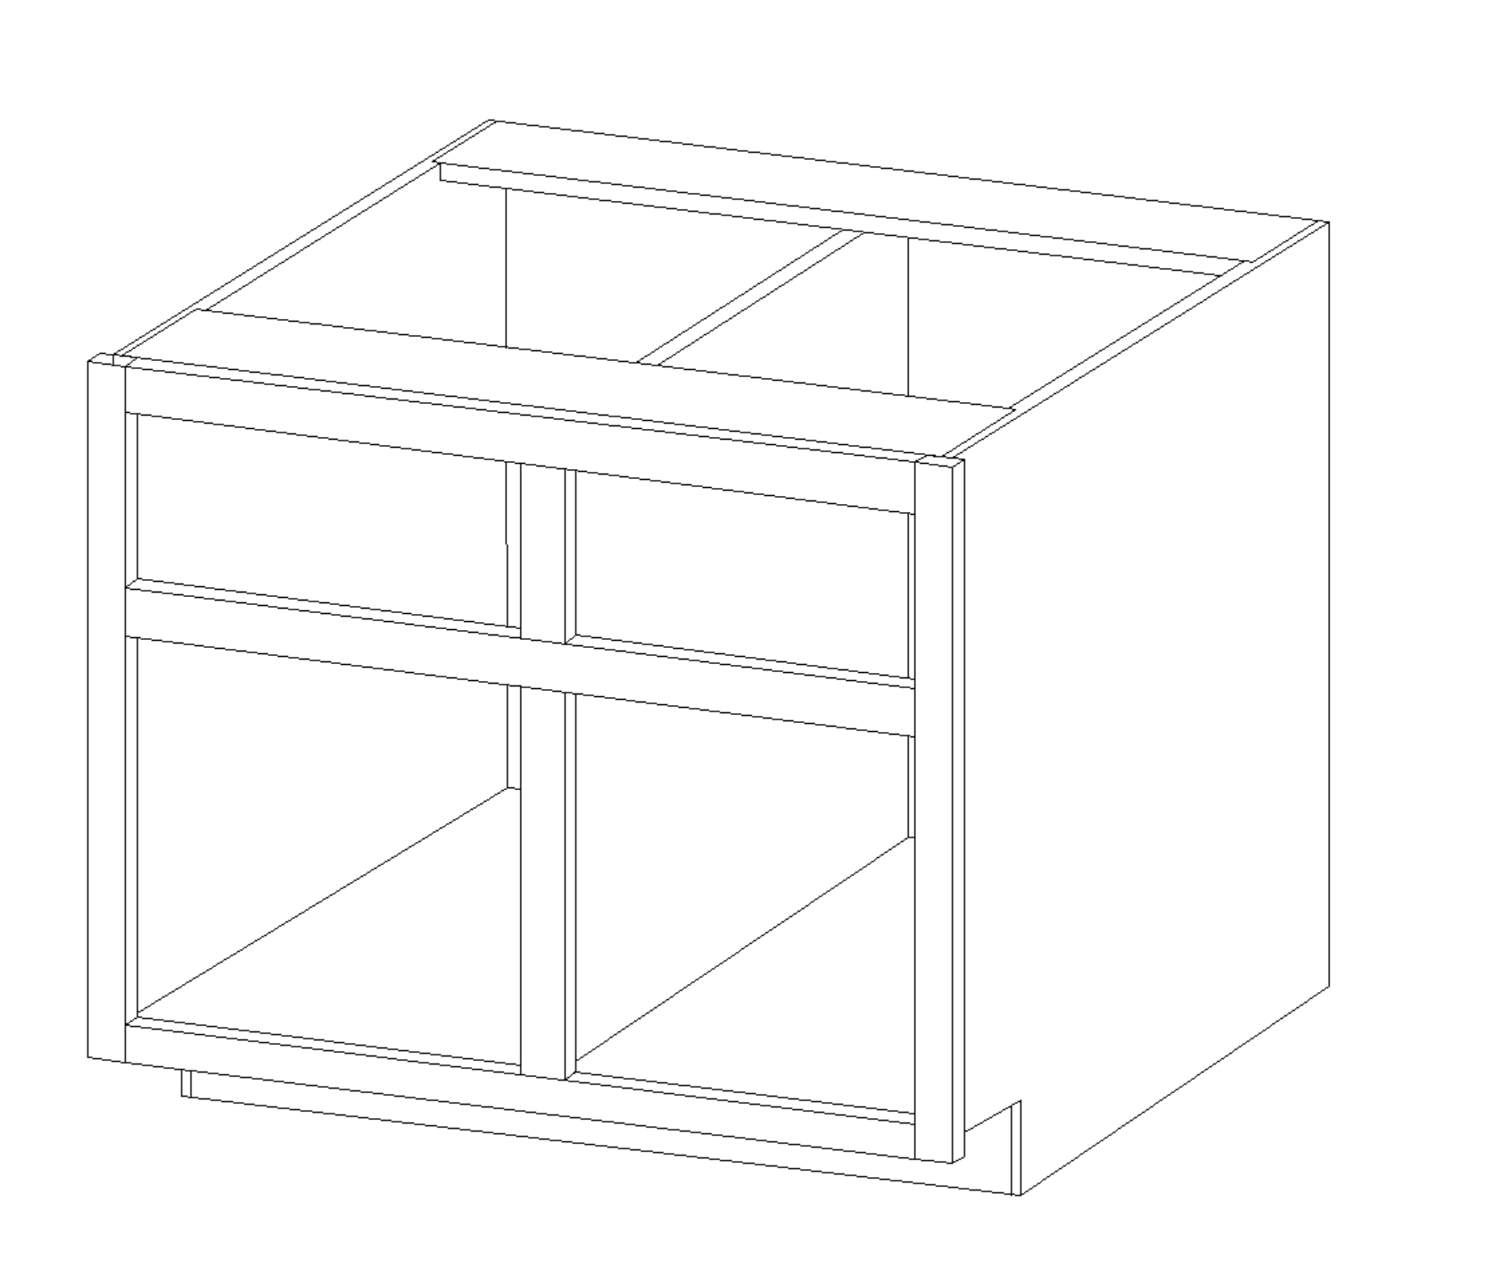
VCarve Pro 11.010 - {James L Anderson} - [Base-03]
B
A
C

Slide 2
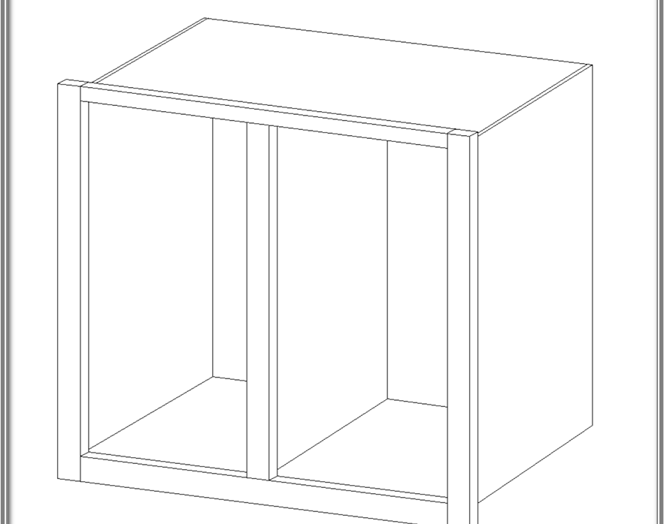
Top Panel
F
D
G
Inside
Wall Top Rail Section

Slide 3
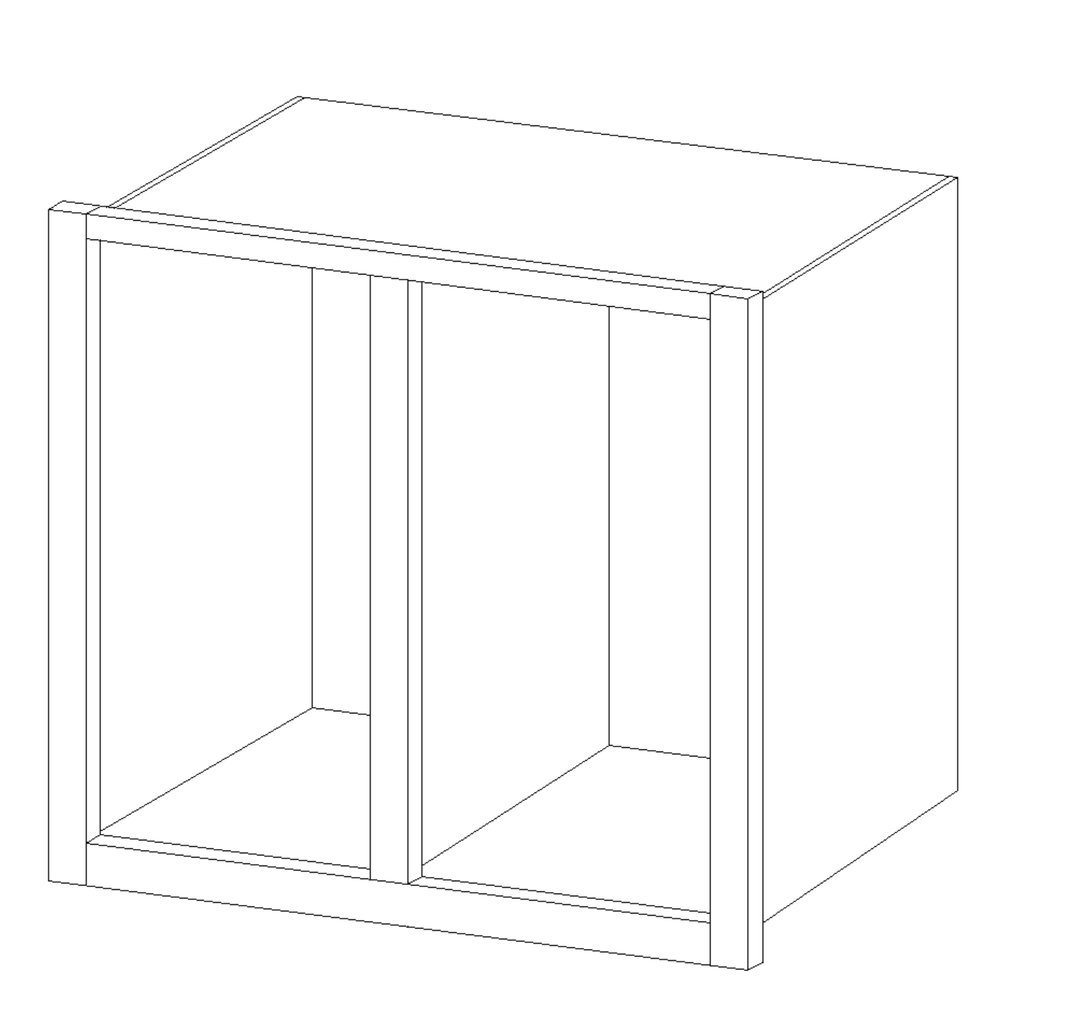
VCarve Pro 11.010 - {James L Anderson} - [Wall-05]
B
A
C

